Slide 1
Expectation Maximization

Slide 2
The Expectation-Maximization (EM) algorithm is a way to find maximum-likelihood estimates for model parameters when your data is incomplete, has missing data points, or has unobserved (hidden) latent variables.
It is an iterative way to approximate the maximum likelihood function. While maximum likelihood estimation can find the “best fit” model for a set of data, it doesn’t work particularly well for incomplete data sets.
The more complex EM algorithm can find model parameters even if you have missing data. It works by choosing random values for the missing data points, and using those guesses to estimate a second set of data.
The new values are used to create a better guess for the first set, and the process continues until the algorithm converges on a fixed point.

Slide 3
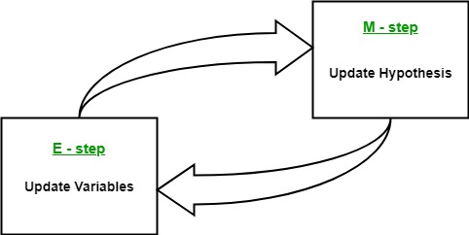
EM takes a guess at the parameters first—accounting for the missing data—then tweaks the model to fit the guesses and the observed data. The basic steps for the algorithm are:
Given a set of incomplete data, consider a set of starting parameters.
Expectation step (E – step): Using the observed available data of the dataset, estimate (guess) the values of the missing data.
Maximization step (M – step): Complete data generated after the expectation (E) step is used in order to update the parameters.
Repeat step 2 and step 3 until convergence.

Slide 4
The EM Algorithm always improves a parameter’s estimation through this multi-step process.
However, it sometimes needs a few random starts to find the best model because the algorithm can hone in on a local maxima that isn’t that close to the (optimal) global maxima. In other words, it can perform better if you force it to restart and take that “initial guess” from Step 1 over again. From all of the possible parameters, you can then choose the one with the greatest maximum likelihood.
In reality, the steps involve some pretty heavy calculus (integration) and conditional probabilities.

Slide 5
The essence of EM algorithm is to use the available observed data of the dataset to estimate the missing data and then using that data to update the values of the parameters.
Initially, a set of initial values of the parameters are considered. A set of incomplete observed data is given to the system with the assumption that the observed data comes from a specific model.
The next step is known as “Expectation” – step or E-step. In this step, we use the observed data in order to estimate or guess the values of the missing or incomplete data. It is basically used to update the variables.
The next step is known as “Maximization”-step or M-step. In this step, we use the complete data generated in the preceding “Expectation” – step in order to update the values of the parameters. It is basically used to update the hypothesis.
Now, in the fourth step, it is checked whether the values are converging or not, if yes, then stop otherwise repeat step-2 and step-3 until the convergence occurs.

Slide 6
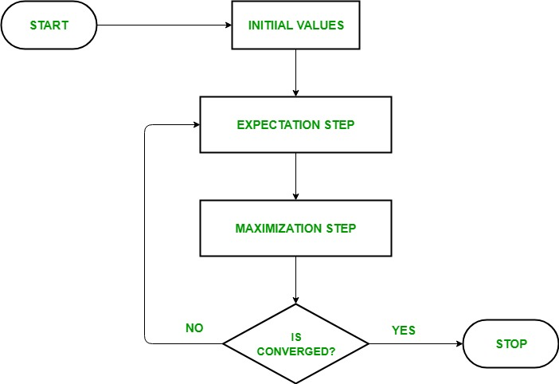
FlowChart

Slide 7
Usage of EM algorithm –
It can be used to fill the missing data in a sample.
It can be used as the basis of unsupervised learning of clusters.
It can be used for the purpose of estimating the parameters of Hidden Markov Model (HMM).
It can be used for discovering the values of latent variables.
Advantages of EM algorithm –
It is always guaranteed that likelihood will increase with each iteration.
The E-step and M-step are often pretty easy for many problems in terms of implementation.
Solutions to the M-steps often exist in the closed form.

Slide 8
Disadvantages of EM algorithm –
It has slow convergence.
It makes convergence to the local optima only.
It requires both the probabilities, forward and backward (numerical optimization requires only forward probability).

Slide 9
HMM
Future event depends upon the present event
Unknown Variable is state for happy or sad
W(Watching) , Crying(C ) , Facebooking (f) , Sleeping (S)
Probability Expectations only can be done
Visual observation :

Slide 10


